Slide 1
UTILIZING MACHINE LEARNING AND NEURAL NETWORK MODELS FOR DETECTING ILLICIT TRANSACTIONS IN ETHEREUM BLOCKCHAIN
By
Madhumitha Ramajeyathilagam
Student Id:1037507
Master’s in Data Science
LIVERPOOL JOHN MOORES UNIVERSITY
Under supervision of
Dr. Nilam Upasani

Slide 2
INTRODUCTION
Fiat currencies requires third parties such as bank to process transactions. But the blockchain widely used by Ethereum and Bitcoin removes need for third parties.
Blockchain is a distributed, immutable, decentralized database that makes it possible to track assets and record transactions.
But the blockchains are also vulnerable to security issues like phishing attacks, fraudulent transactions, and majority attacks.
In an article published by FTC in June,2022 nearly 46000 people have been scammed of $1 billion in cryptocurrency.
A methodology has been developed in this study to find fraudulent transactions in the Ethereum Blockchain and to help thwart fraud.

Slide 3
AIM and OBJECTIVES
The primary aim of this study is to build a model to detect the illicit transactions in the Ethereum blockchain.
To utilize feature selection techniques to find the most important features of fraudulent transactions and visualization of the most important input features to examine the pattern and relationships between them.
To make a reasonable balancing technique recommendation that can be used on the unbalanced dataset.
To compare the predicted models and determine which one is more accurate to predict the illicit transaction accounts based on the important features selected.
To assess how well proposed machine learning or neural network models perform.

Slide 4
RESEARCH QUESTIONS
How can we generate a generalized model to detect the illicit transactions in the Ethereum Blockchain?
How is the dataset available for research structured. Does it further need any restructuring before implementing the models?
What are the various attributes influencing in determining the illicit transaction and how well can we define them?
What are the parameters tuning needed to improve the model performance ?
Does the performance metrics effectively contribute in determining the illicit transaction?

Slide 5
LITERATURE SURVEY
Proposed a model using unsupervised model to cluster the dataset and then used Random forest to detect the cluster containing anomalous records.
Model obtained a F1-score of 0.96
Network embedding method for automatic feature extraction and used GCN model. F1 score 0.95,Recall 0.94,Precision 0.96 Accuracy 0.95
Proposed a model using 10-fold cross validation with XGBoost model. F1-score of 0.96 and accuracy of 0.963.
Proposed a model using Standard scaler with SMOTE technique and XGBoost model. Accuracy of 99.21%
Baek et al
Farrugia et al
Tan et al
Maurya and Kumar
2019
2021
2022
2019
2020
2021
2022
Ostapowicz and Żbikowski
Ibrahim et al
Aziz et al
Proposed a 10 –fold cross validation grid search cv Random Forest model. Recall of 84.92%
Proposed a model using Random forest algorithm. Accuracy 98.16% and F-measure of 97.4%.
Proposed a model using SMOTE data balancing technique and Light Gradient Boosting Machine model. Accuracy of 99.03%

Slide 6
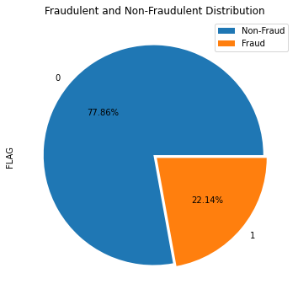
PROPOSED METHODOLOGY
The dataset has 9841 records and 51 columns.
The data is cleaned and power transformer is applied on the dataset since it is right skewed.
The important feature are extracted using the Correlation coefficient and Information gain.
The data is imbalanced as shown in the figure therefore we proceed by using Over sampling, SMOTE and ADASYN techniques.
Various models such Logistic Regression, DT, RF, XGBoost, ADABoost, Gradient Boost model, LGBM, CatBoost ,SVM ,KNN ,Naive Bayes, ANN are employed along with hyper parameter tuning using 10-fold Randomized search cross-validation technique.
The final model is decided based on the Precision, Recall and F1-score and execution time.

Slide 7
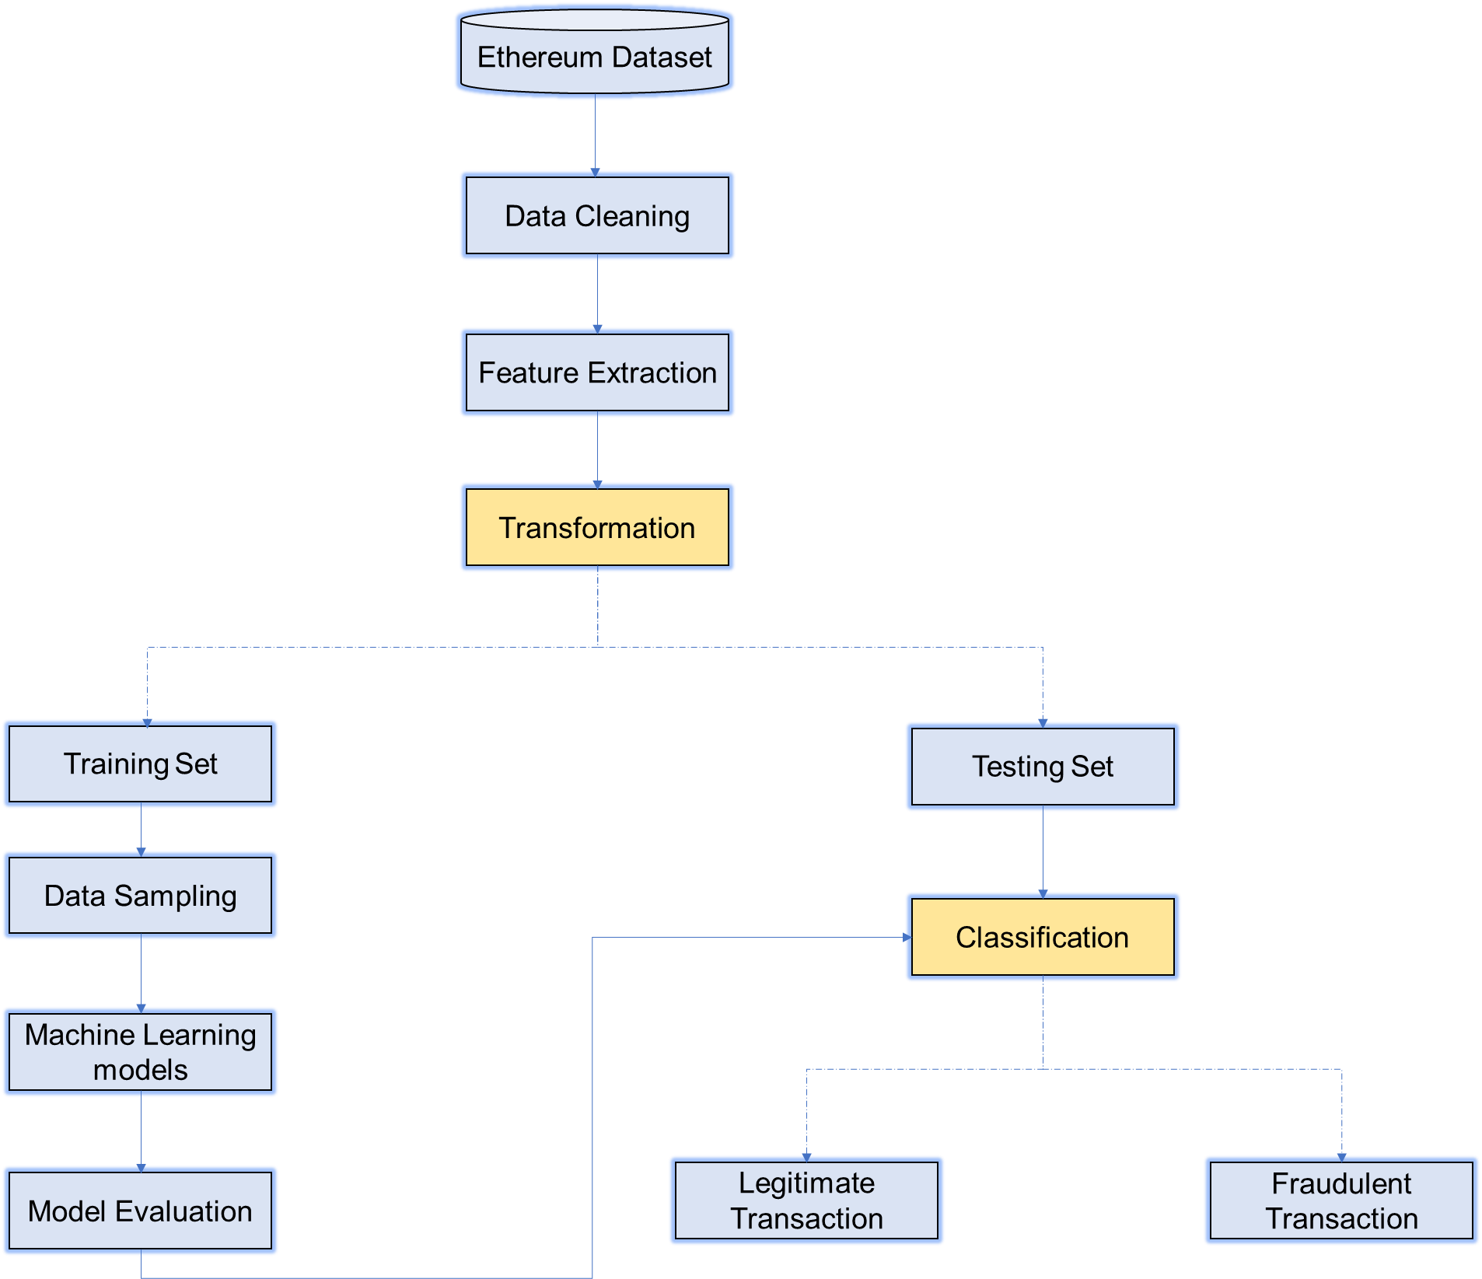

Slide 8
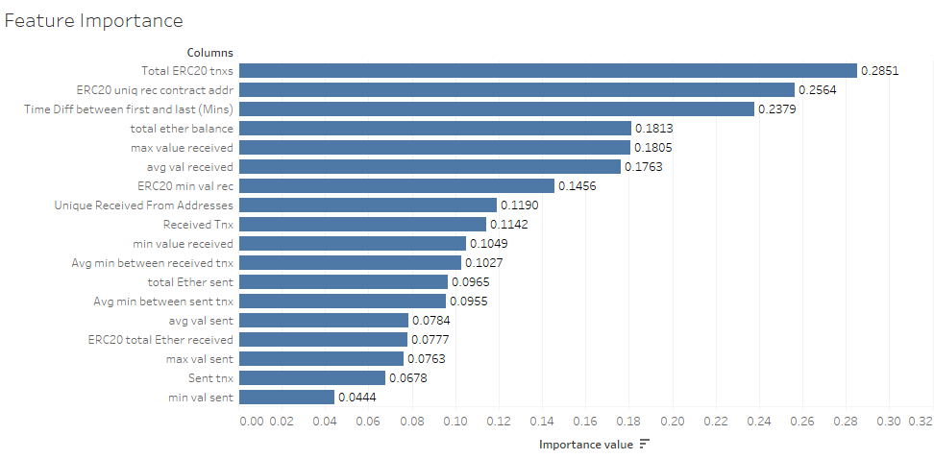
RESULTS AND DISCUSSION
“Total ERC20 tnxs," "ERC20 uniq rec contract addr," "Time Diff between first and last (Mins")," "total ether balance," and "max value received" are the top 5 attributes.

Slide 9
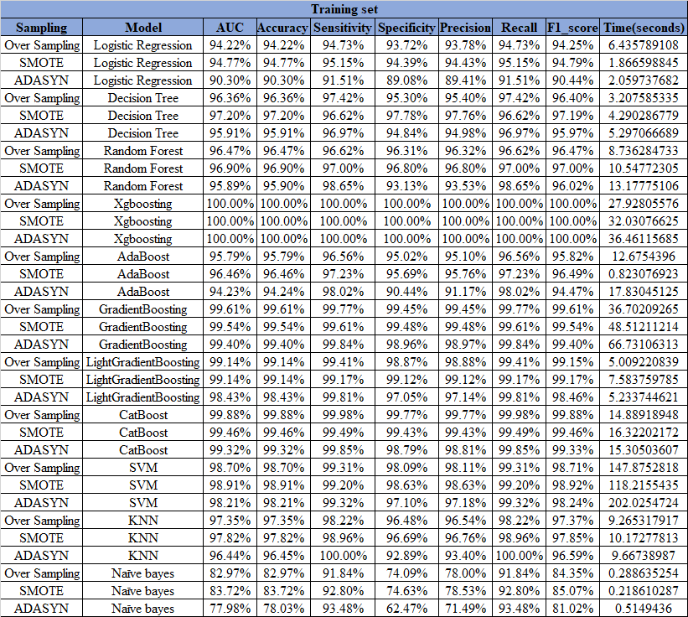

Slide 10
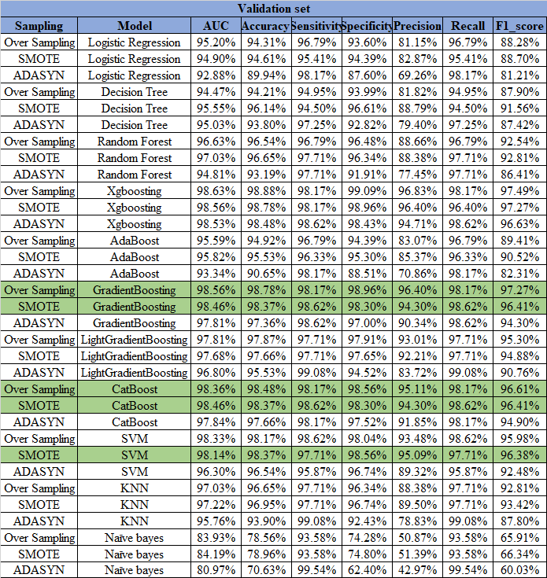

Slide 11
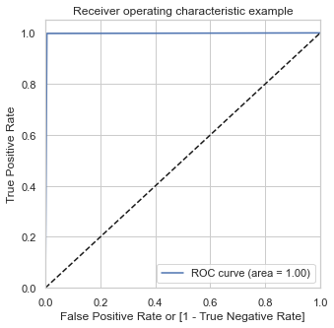
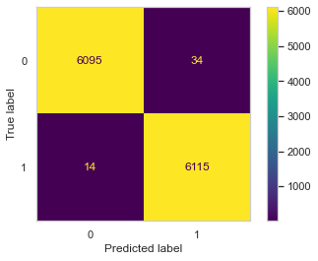
Gradient Boost Model
Confusion Matrix of the Training set for Over Sampling Gradient Boost model
ROC curve of the Training set for Over sampling Gradient Boost model

Slide 12
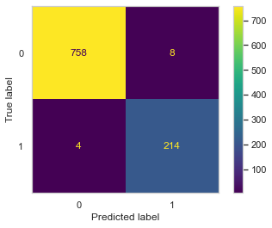
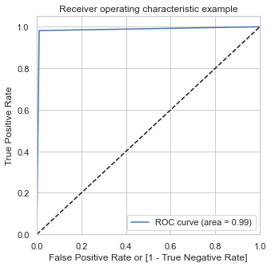
Gradient Boost Model
Confusion Matrix of the Validation set for Over Sampling Gradient Boost model
ROC curve of the Validation set for Over sampling Gradient Boost model

Slide 13

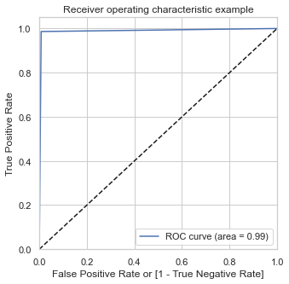
Gradient Boost Model
Confusion Matrix of the Testing set for Over Sampling Gradient Boost model
ROC curve of the Testing set for Over sampling Gradient Boost model

Slide 14
The training set data has an Accuracy of 99.6%, Precision of 99.45%, Recall of 99.7% and F1-score of 99.6%
The validation set data has Accuracy of 98.78%, Precision of 96.4%, Recall of 98.17% and F1-score of 97.27%.
The testing set data has an Accuracy of 99.08%, Precision of 97.29%, Recall of 98.62%, F1-score of 97.95%.

Slide 15
CONCLUSION AND RECOMMENDATION
CONCLUSION
RECOMMENDATION
Feature selection is performed using Correlation coefficient and Information gain.
Oversampling data balancing technique is used to adjust the imbalance.
The Gradient Boost model applied on the testing data set it has an Accuracy of 99.08%, Precision of 97.29%, Recall of 98.62%, F1-score of 97.95%.
Model build is robust and can be used to enhance the security of Ethereum Blockchain and gain the confidence of the end users.
Increase end users' awareness of these accounts and transactions and improve their knowledge.
High model performance is true while employing the same algorithms in subsequent works on a larger data set.
Try experimenting with different neural network models like CNN,RNN etc. to see if they perform better than ML model.

Slide 16
REFERENCES
Aziz, R.M., Baluch, M.F., Patel, S. and Ganie, A.H., (2022) LGBM: a machine learning approach for Ethereum fraud detection. International Journal of Information Technology. [online] Available at: https://link.springer.com/10.1007/s41870-022-00864-6.
Baek, H., Oh, J., Kim, C.Y. and Lee, K., (2019) A Model for Detecting Cryptocurrency Transactions with Discernible Purpose. In: 2019 Eleventh International Conference on Ubiquitous and Future Networks (ICUFN). [online] IEEE, pp.713–717. Available at: https://ieeexplore.ieee.org/document/8806126/.
Farrugia, S., Ellul, J. and Azzopardi, G., (2020) Detection of illicit accounts over the Ethereum blockchain. Expert Systems with Applications, [online] 150, p.113318. Available at: https://linkinghub.elsevier.com/retrieve/pii/S0957417420301433.
Ibrahim, R.F., Mohammad Elian, A. and Ababneh, M., (2021) Illicit Account Detection in the Ethereum Blockchain Using Machine Learning. In: 2021 International Conference on Information Technology (ICIT). [online] IEEE, pp.488–493. Available at: https://ieeexplore.ieee.org/document/9491653/.
Maurya, A. and Kumar, A., (2022) Credit card fraud detection system using machine learning technique. In: 2022 IEEE International Conference on Cybernetics and Computational Intelligence (CyberneticsCom). [online] IEEE, pp.500–504. Available at: https://ieeexplore.ieee.org/document/9865466/.
Ostapowicz, M. and Żbikowski, K., (2019) Detecting Fraudulent Accounts on Blockchain: A Supervised Approach. [online] Available at: http://arxiv.org/abs/1908.07886.
Tan, R., Tan, Q., Zhang, P. and Li, Z., (2021) Graph Neural Network for Ethereum Fraud Detection. In: 2021 IEEE International Conference on Big Knowledge (ICBK). [online] IEEE, pp.78–85. Available at: https://ieeexplore.ieee.org/document/9667674/.

Slide 17
APPENDIX
The Ethereum dataset used for modelling, model building and EDA python codes, the results are uploaded in the GitHub. Link to my GitHub account: (https://github.com/Madhu2409/Master-Thesis).

Slide 18
THANK YOU

